Slide 1
These plots explore the KI vs load behavior and J-integral values for one of Sid’s cases

Slide 2
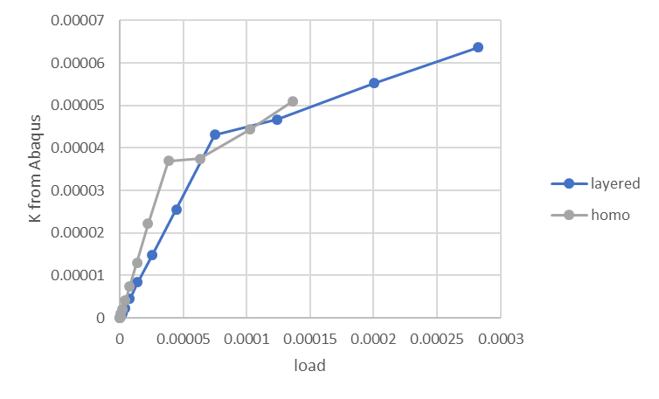
Why the softening behavior?
Simulations suggest geometry affects the softening to a small extent.
For 2D plane strain with a cylinder in contact, there is no softening.
Is this softening affect an error of some kind or a valid artifact of the spherical indenter?

Slide 3
Comparison of Jfar and Jtip for simulation time =0.35 and 10
These plots look identical except for magnitude.
This suggests there is little evolution in the material force at interfaces and there is no expectation that shielding effects would change K
Large oscillations in Jfar when more contours are use..

Slide 4
Plotting the material force (point) force in front of the crack tip
This demonstrates that the oscillations in material force are not due to the interfaces in front of the crack tip.
Interface in front of crack tip
Each subsequent contour is further from the crack tip and closer to the indenter

Slide 5
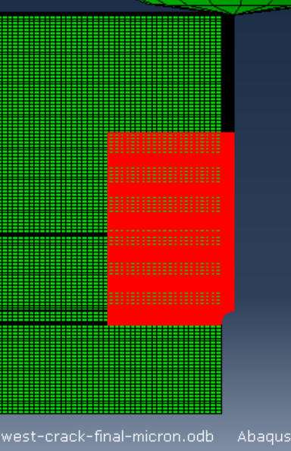
Plotting the material force (point) force behind the crack tip
Some of the strong oscilations appear near the notch area.
Elements for contour 39
At the notch

Slide 6
Why do we get softening?
A possible explanation is that something is wrong with the Abaqus K value we are pulling from the history. I checked the other K modes, but they remain zero. Any other thoughts as to why these are off?
My code was validated by comparing J-integral with Abaqus J-integral output ( not J from K)
If you were to rerun one of the simulations that exhibited softening with J-integral output, you might get the same results that I did.
I don’t think I had the right properties, so the plotted magnitudes of k are not correct. Just run the scripts above with the right properties. (double click.. They are embedded)

